Slide 1

Mellifloo: Art Gallery
Application
Aaron Castillo – Senior:
Jose Raphael – Senior:
Erick Nevarez – Senior:
castilo_a35227@utpb.edu
masonsong_j50042@utpb.edu
nevarez_e97437@utpb.edu
UT-Permian Basin, COSC 4485 – Mobile App Dev

Slide 2
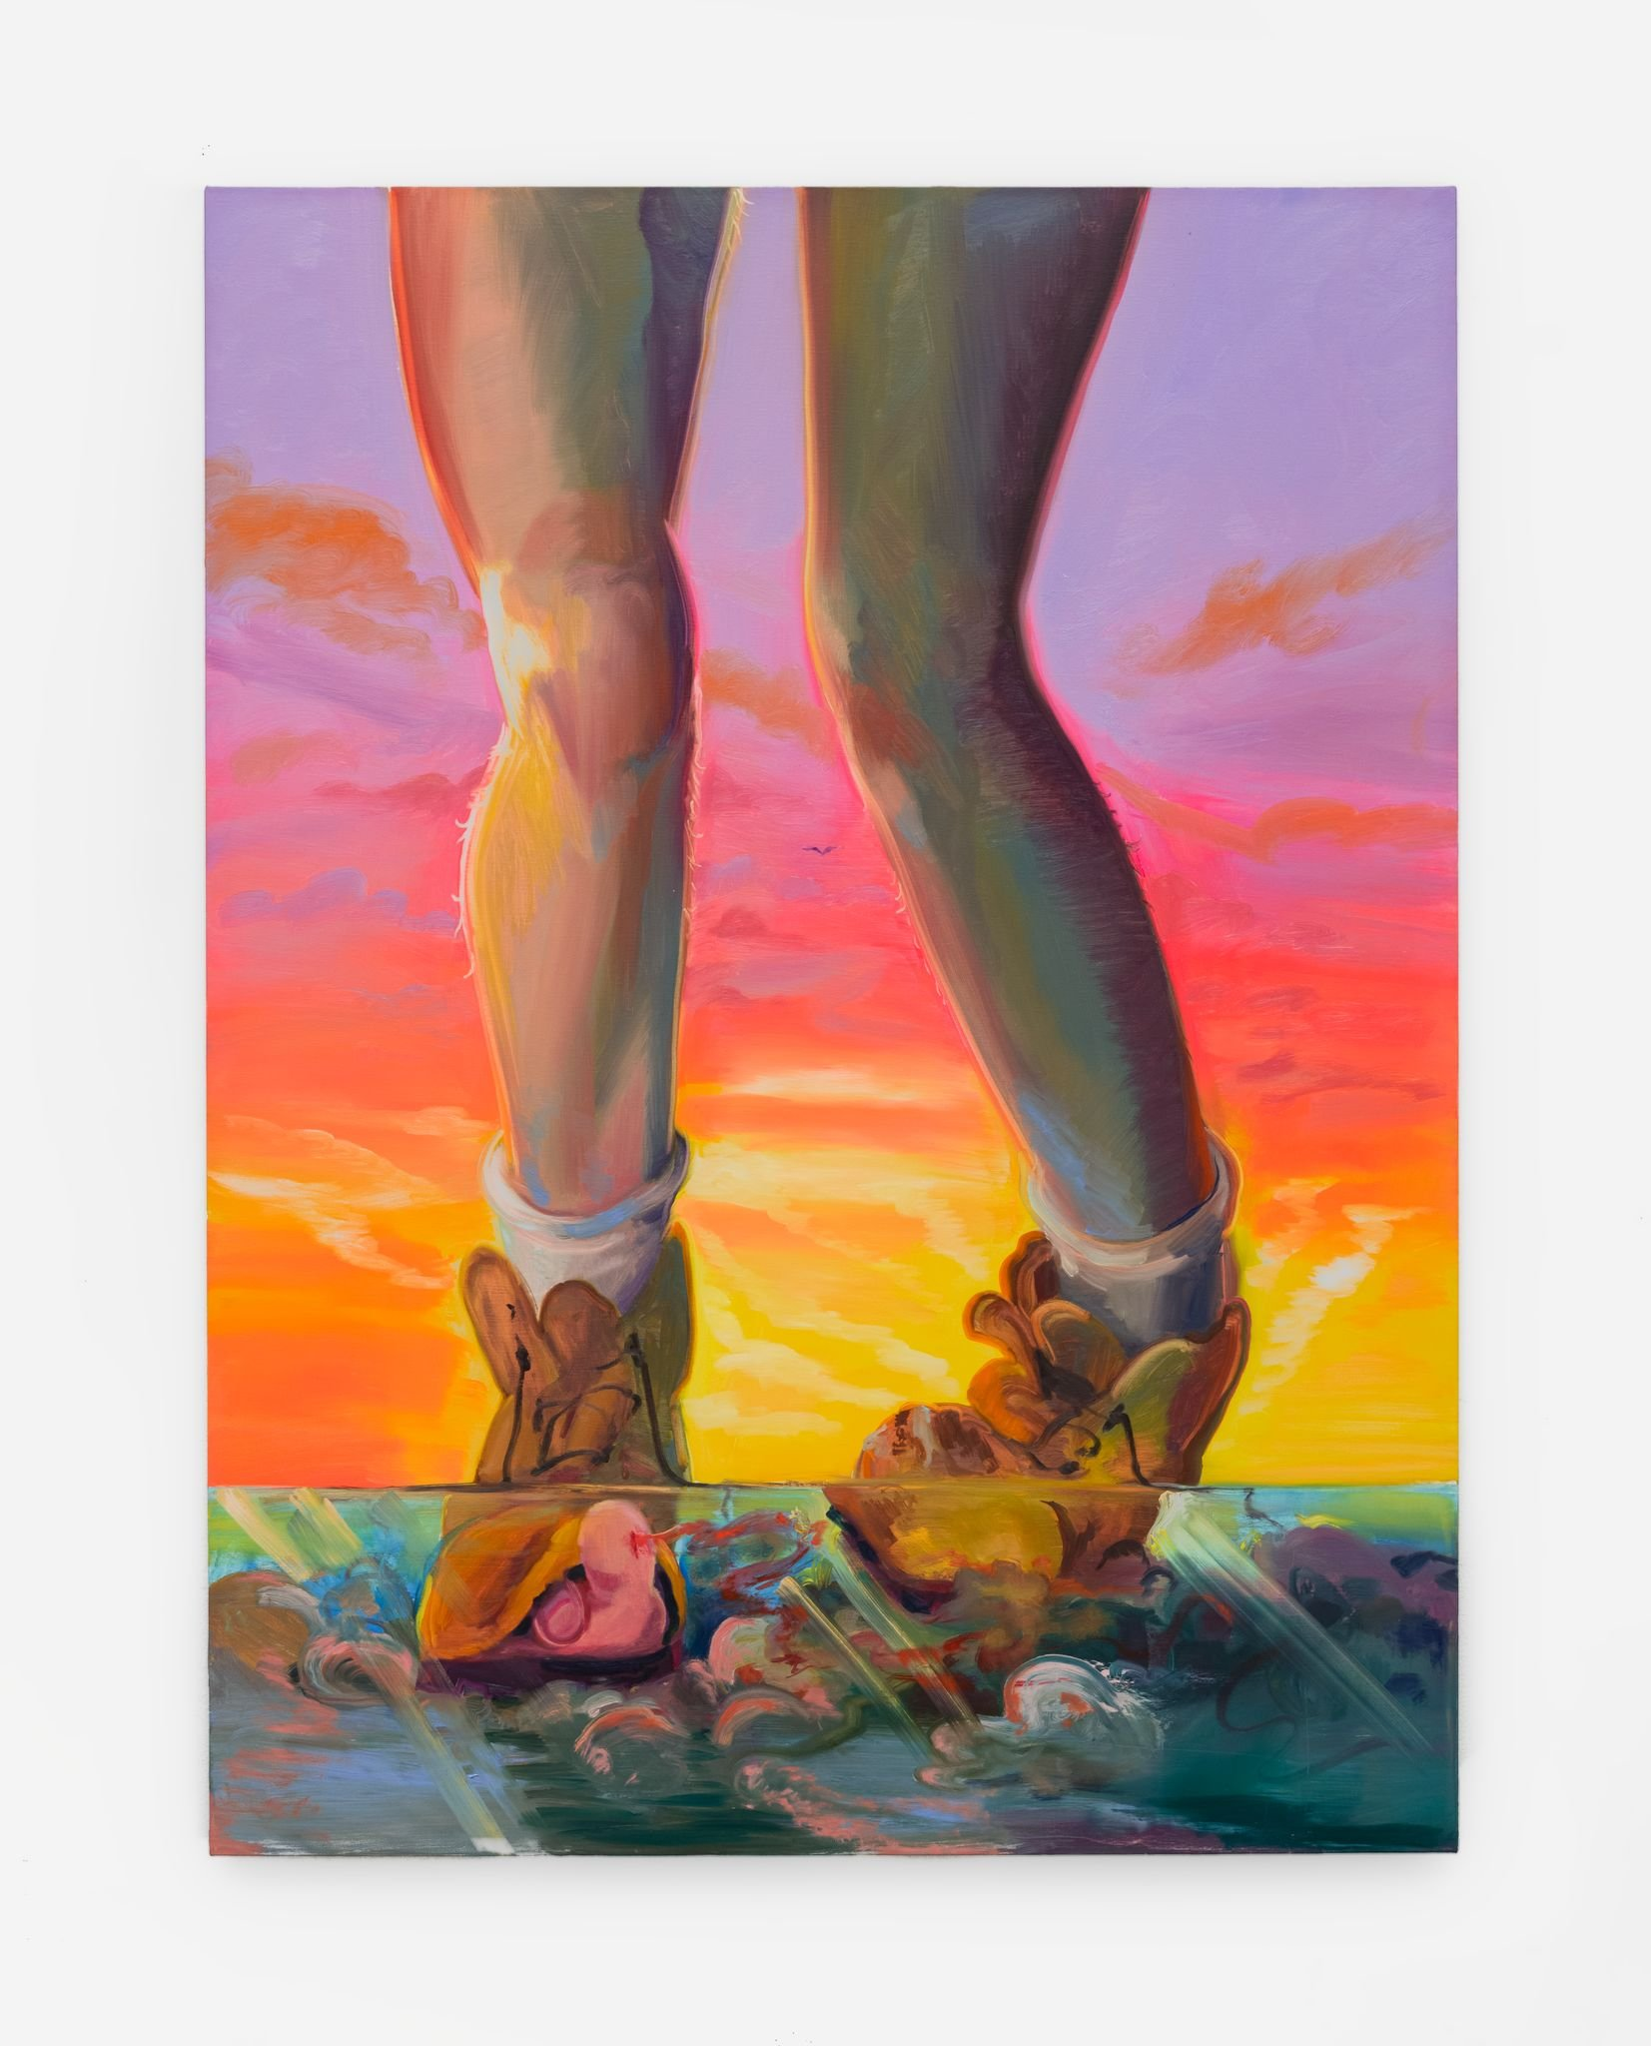
Page / 02
What Does It Do?
Provides access to artwork, exhibition, artist information and Art Gallery information
Enables users to interact with the artworks
Support a virtual tour feature
Who Is It For?
Art enthusiasts
Museum visitors
Museum Directors
Art Gallery
App

Slide 3

Page / 03
What Problems Do We Solve?
Exposure: for Art Galleries to provide a platform to showcase their work to a broader audience, helping them gain visibility and recognition
Event Organization and Information: it includes an exhibition feature, providing information about upcoming exhibitions, and participating artists, etc.
Educational Resource: serve as an educational resource, offering information about different art styles, techniques, and histories of artists or art movements.

Slide 4
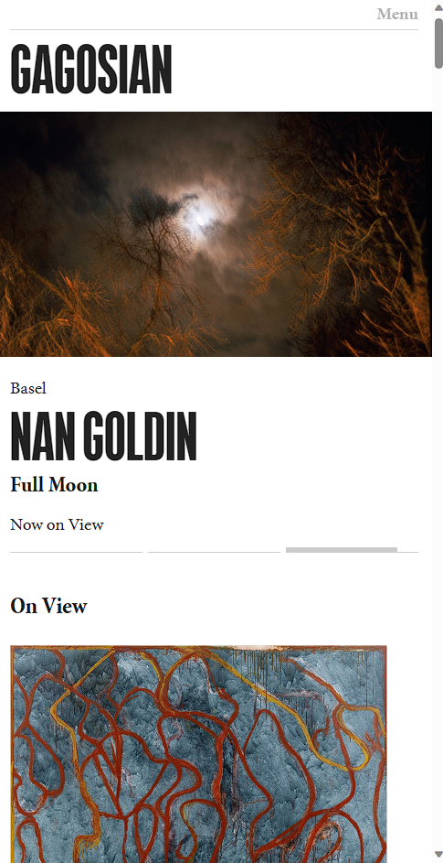
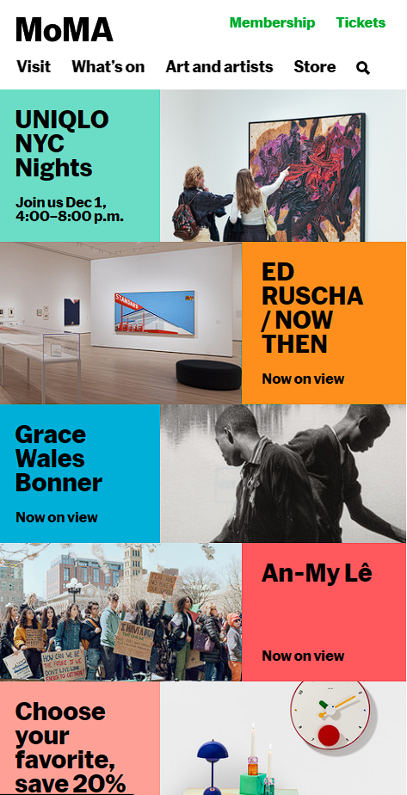
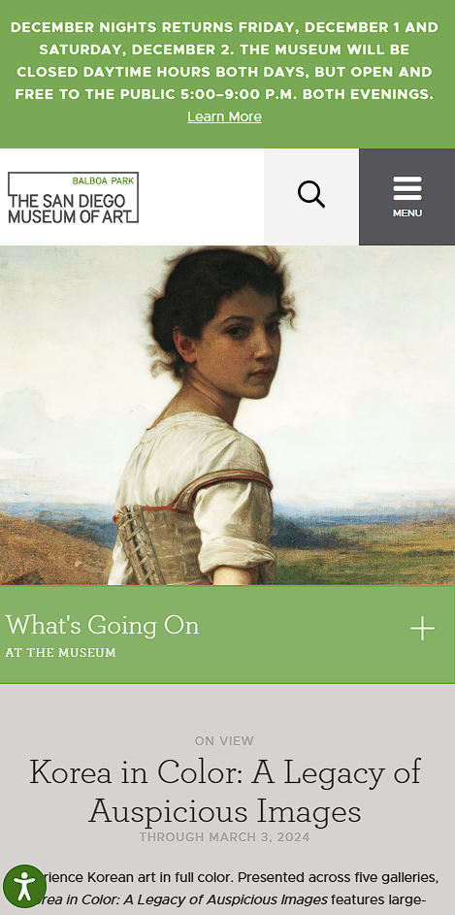
THE COMPETITION
Gagosian
Gagosian
MOMA
MoMA
SDMA
SDMA | San Diego Museum of Art (sdmart.org)
Page / 04

Slide 5

Minimalist and Clean Aesthetics: The aesthetic choices in the app’s design, such as a minimalist interface that reduces clutter, focuses on high-quality visuals, and uses a color scheme that complements the museum's artwork and architecture.
Immersive Content Presentation: The app presents content in an immersive and appealing way to users such as high-quality image galleries and exhibitions.
Offline Access: Providing comprehensive offline access to map, and educational content can be a significant advantage for visitors with limited internet access during their visit
Innovation Relative to Competitors
Page / 05

Slide 6
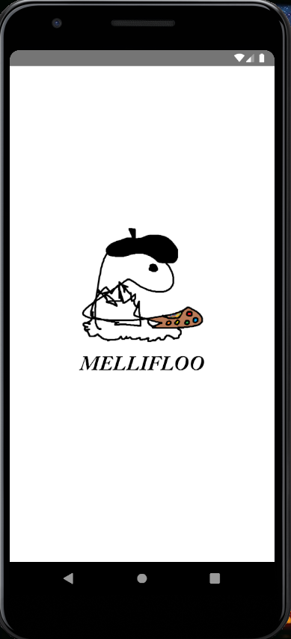
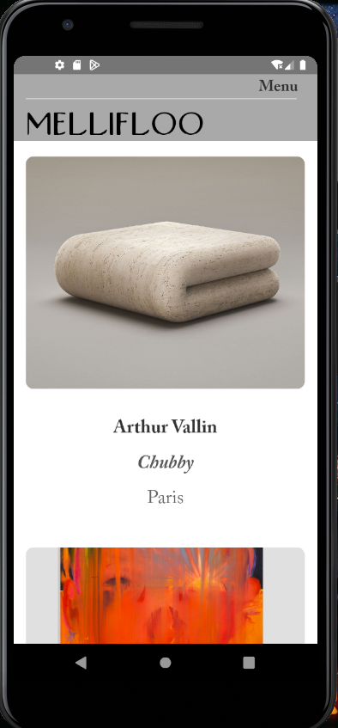
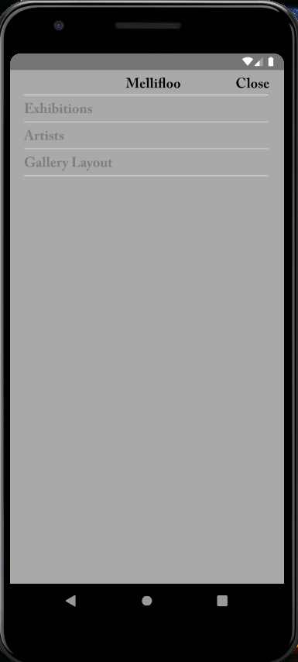
Screens
Logo Screen
2) Home Screen
3) Menu Screen
Page / 06

Slide 7
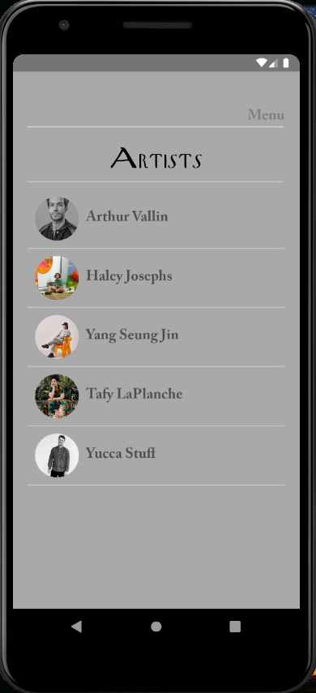
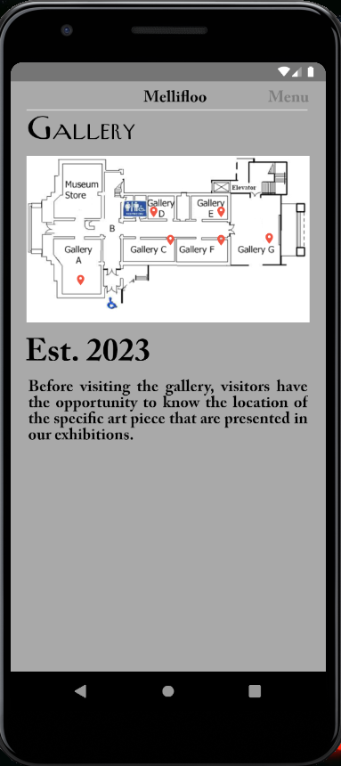
Screens
5) Artists Screen
6) Map Screen
Page / 07

Slide 8
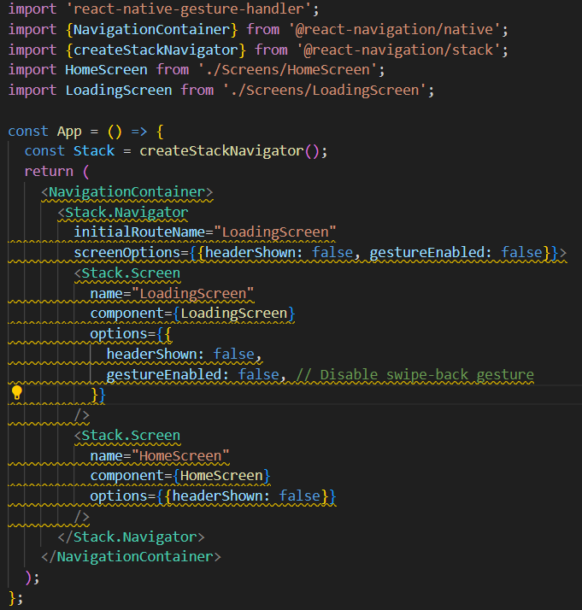
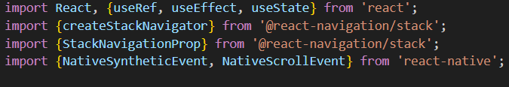
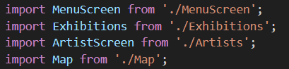
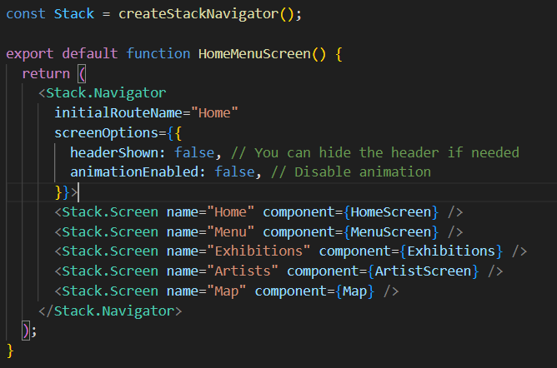
Navigation Between Screens
Page / 08

Slide 9
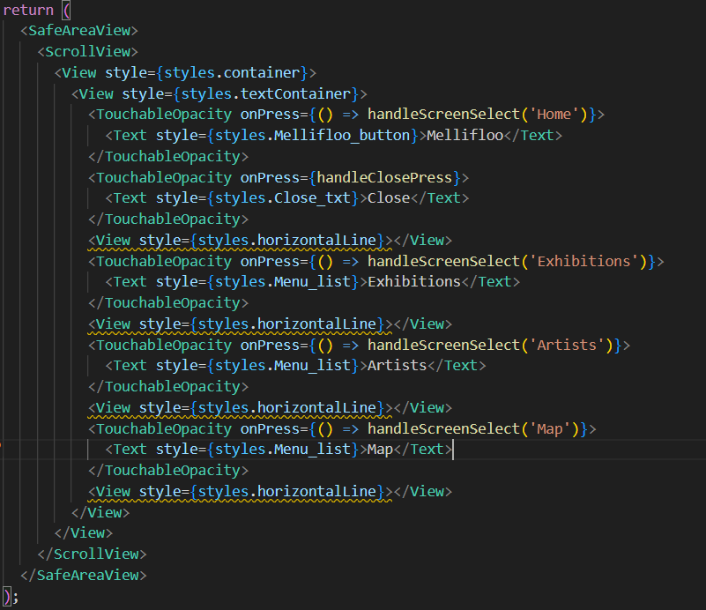
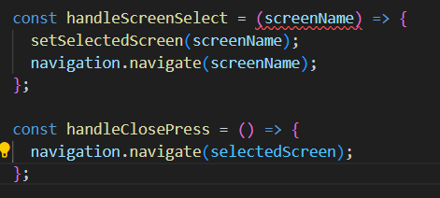
Page / 09

Slide 10
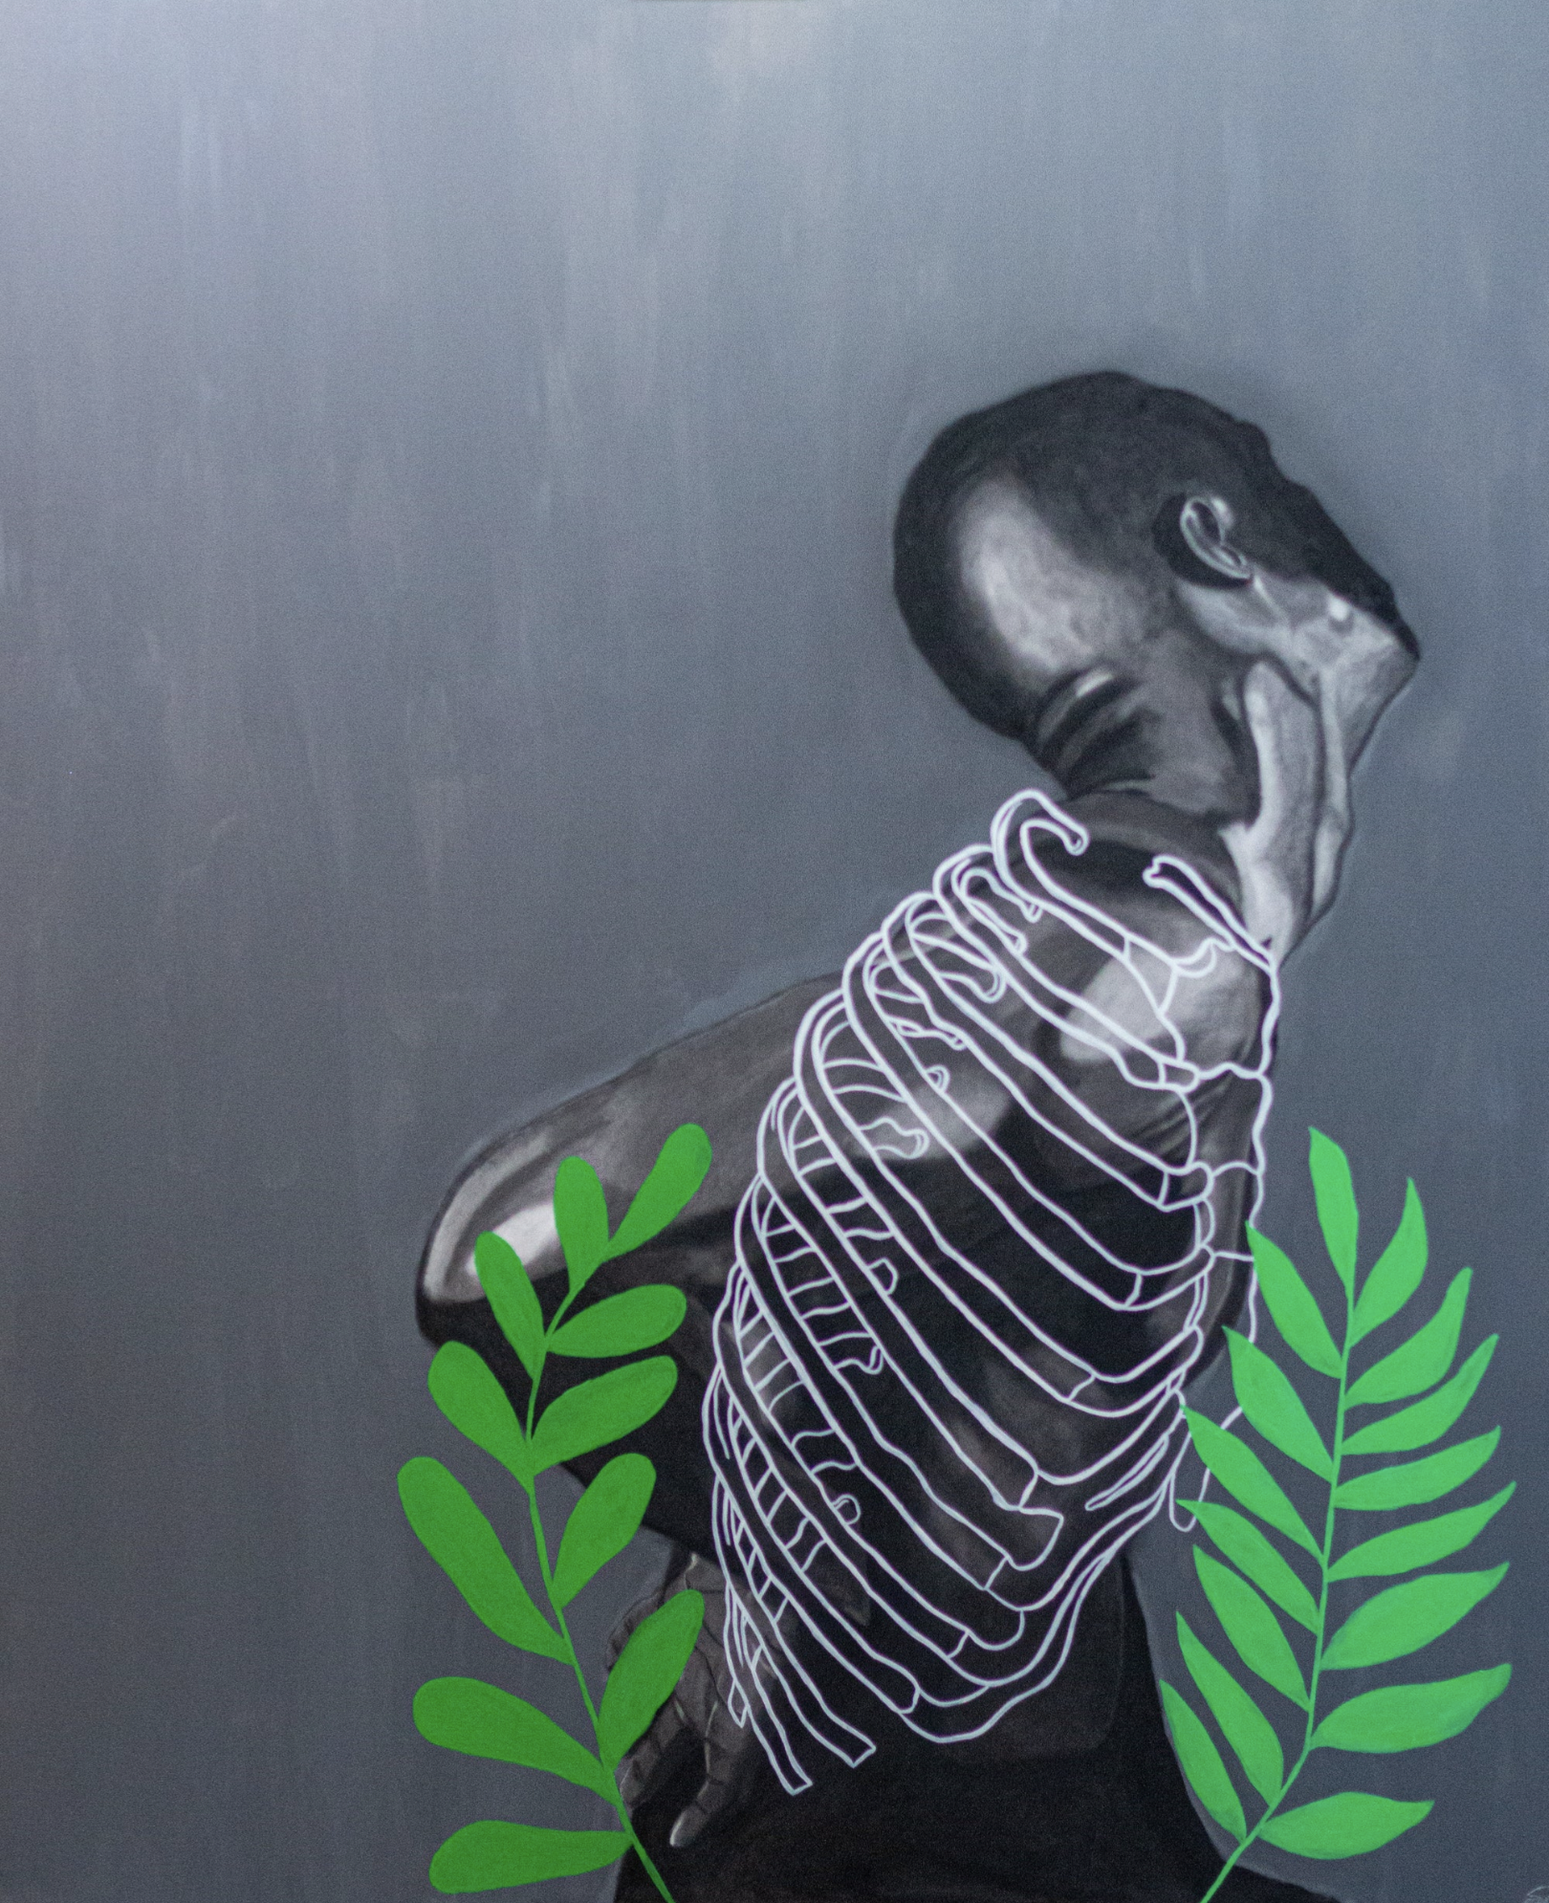
App Features
Artist Profile Display with their featured works and biography.
Exhibition and details of the artwork
Screen Navigation to switch between specific screens
Dynamic Content Loading with Firebase Storage
Lots of Error handling
Minimal Styling to not take away from the artwork
Page / 10

Slide 11
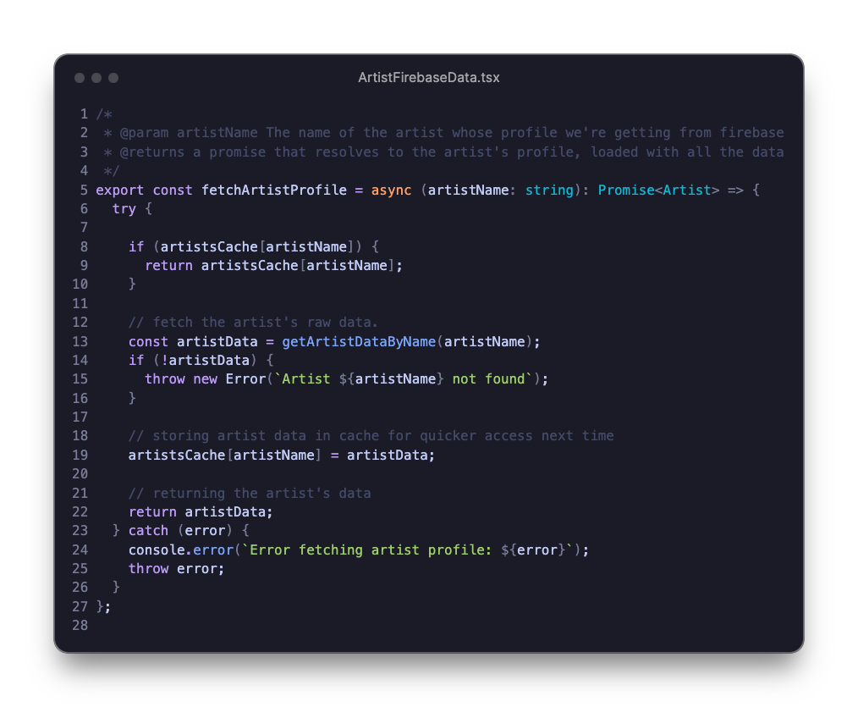
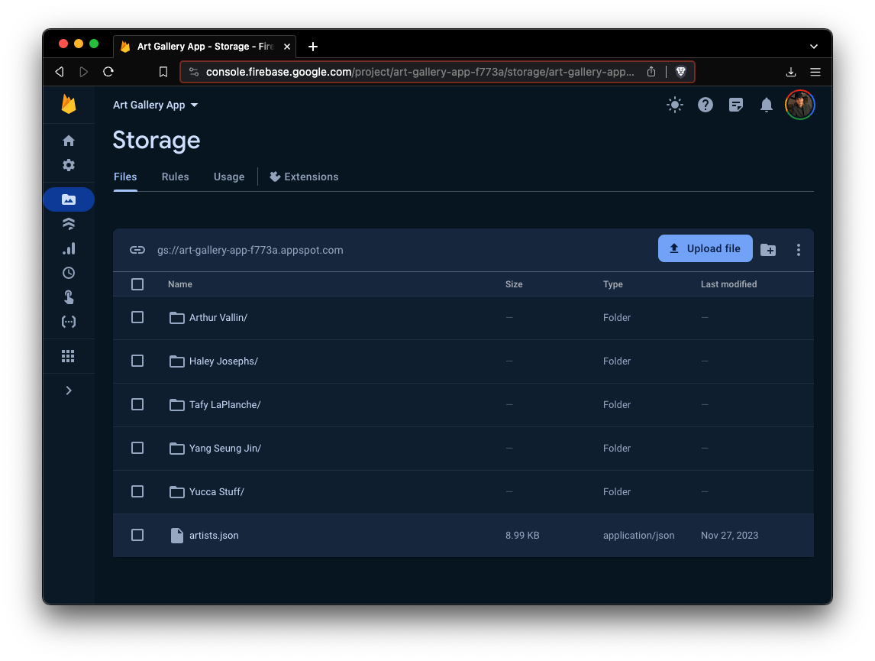
Talking to Firebase Storage
Page / 11

Slide 12
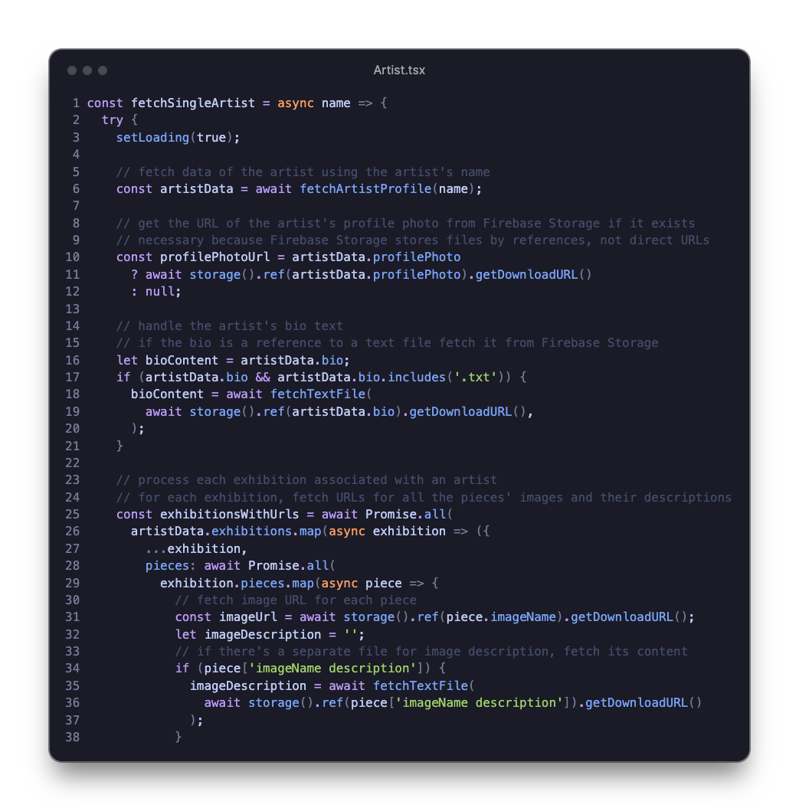
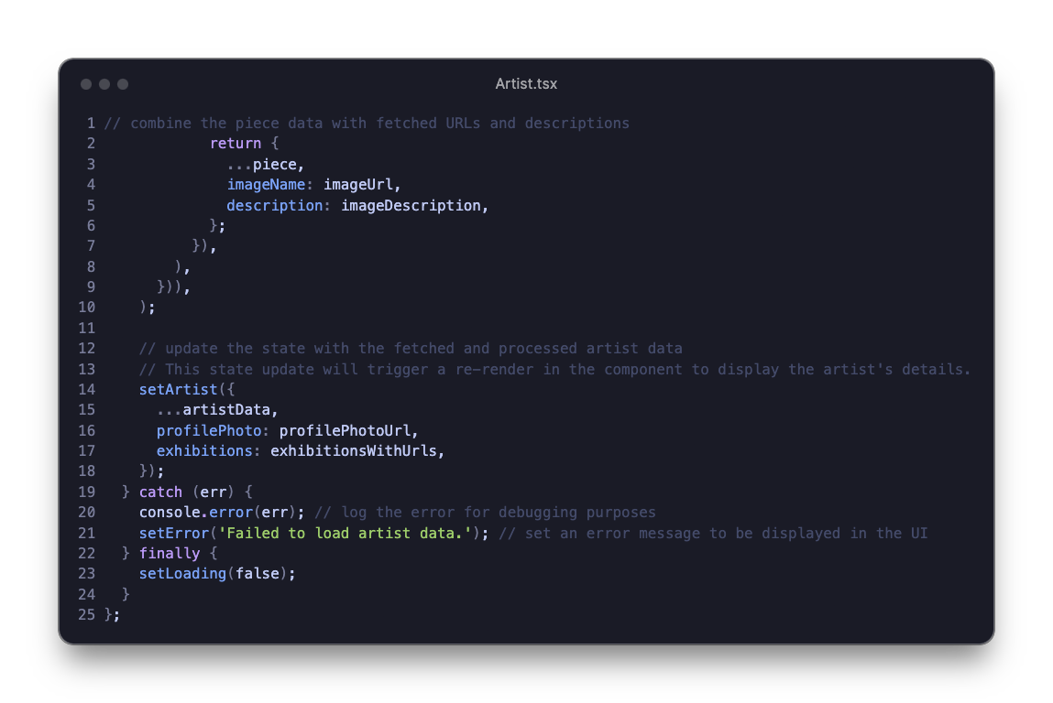
Page / 08

Slide 13
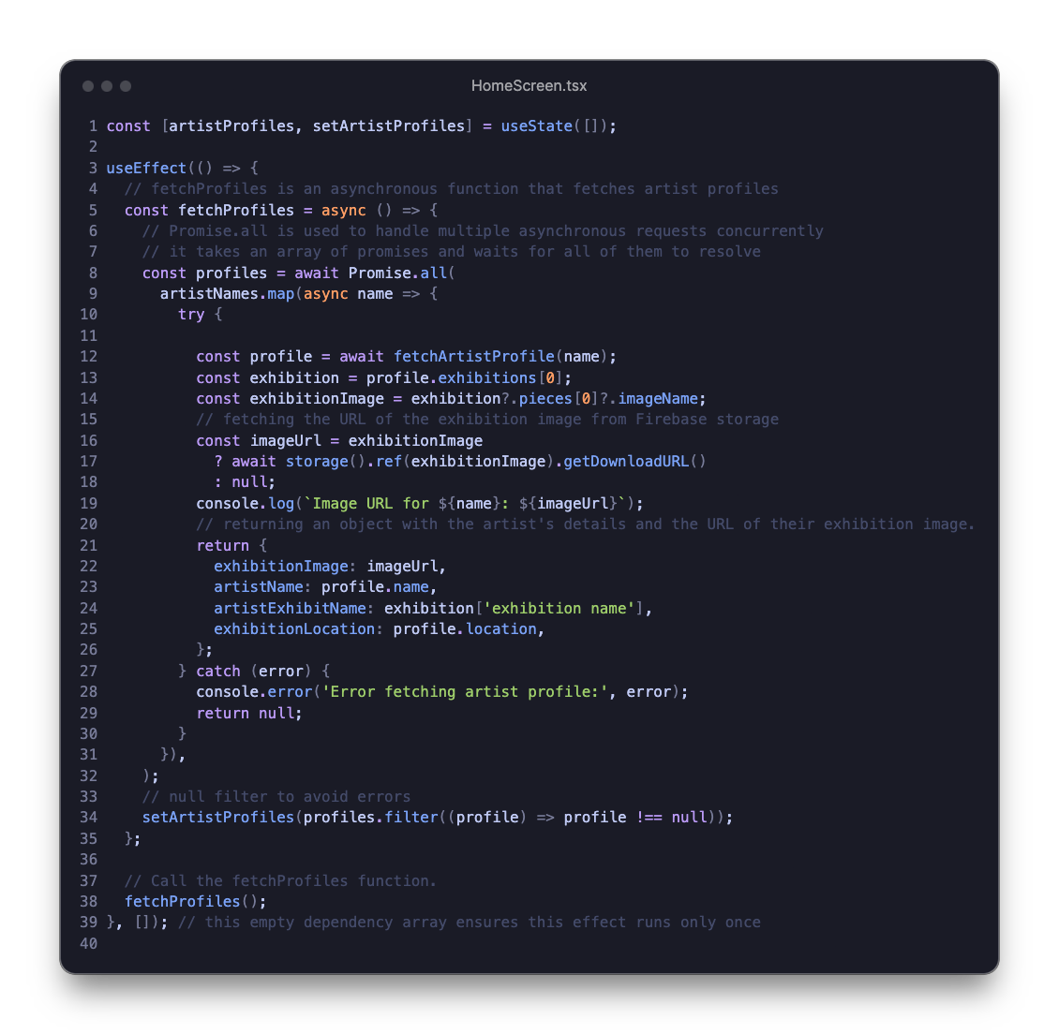
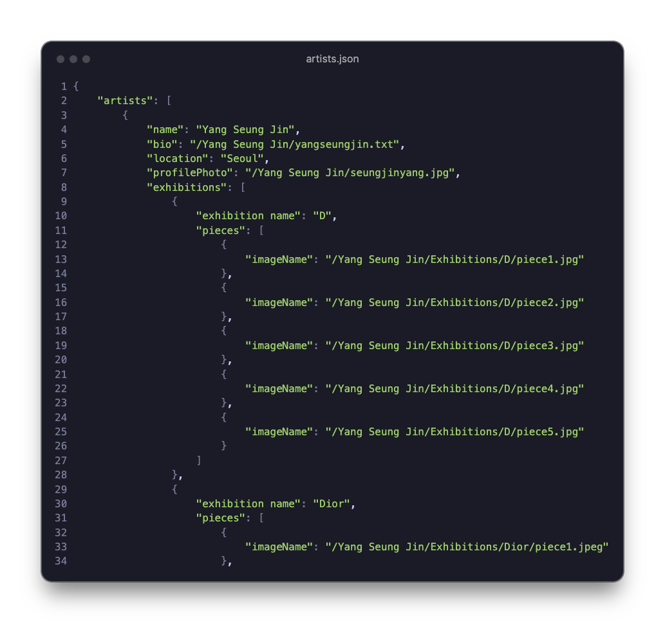
Page / 13

Slide 14
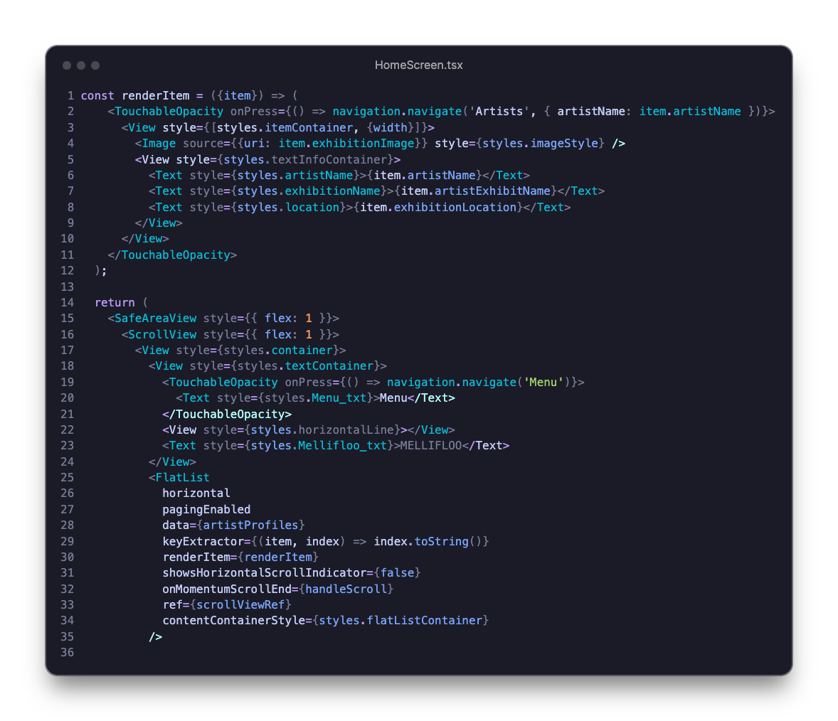
Page / 14

Slide 15
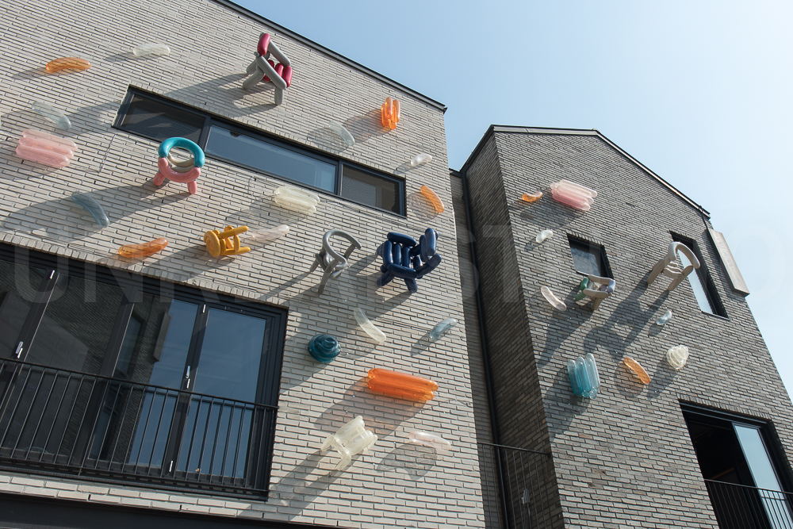

PROJECT DEMO
Page / 09

Slide 16
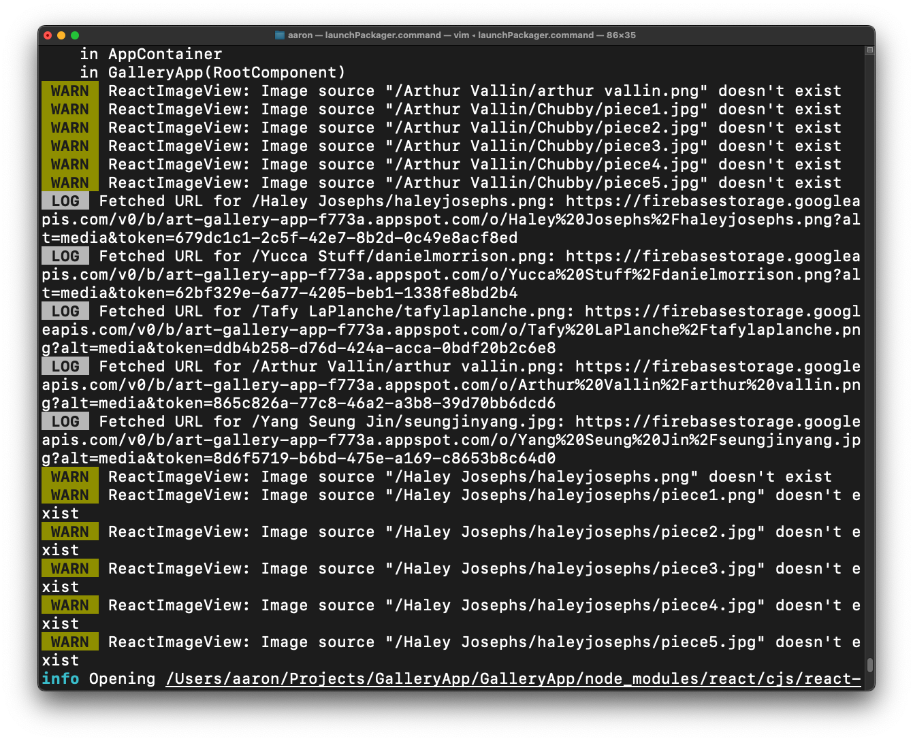
Programming Issues
Setting up Firebase Storage
Working through JSON parsing
Working through the JSON to get URLs from Firebase Storage
Computer Capabilities
Page / 16

Slide 17
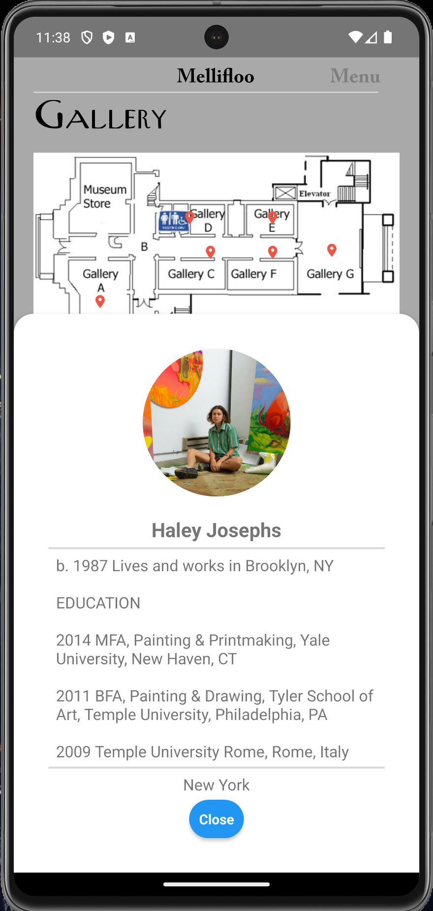
The Future
Developing an admin companion app so that art galleries can directly update and manage app content
App Features – Search, Dynamic Location,
Page / 17

Slide 18
Mellifloo
Thank you for your time
Questions or comments?

